Slide 1

Content overview:
‘Myth-busting’ around work in the Creative Sector
Possibilities and opportunities in the Sector to inspire young people
Transferable skills and knowledge important in the Creative Sector
Performance / showcase to connect with the practitioner’s work.
Sessions to last for 30 – 60 minutes, depending on whether delivery is split or whole group.
  introduction to the creative sector and the practitioner’s career journey
  interactivity for learners
The Brief:
Introduce and Inspire

Slide 2
Suggested approaches and outcomes:
Aim for a personalised, discussion-based session
Refer to PowerPoint but you don't need to cover everything
Showcase your projects and insight into your work patterns
Map out your journey, first steps and accessible entry points
Refer to the PowerPoint resource list for local opportunities and connections.
Let me know if there's anything that would be helpful to add
Delivery notes:
Personalise creative careers

Slide 3
Suggested lead-ins:
Use the myth busting activity included here – complete sentences verbally and share back
Q&A - artist's career (live presenter OR video interviewee if delivered independently)
2 Truths One Lie – artist's career (live presenter OR video interviewee if delivered independently)
Image / sound based introduction to artist's work followed by Q&A (live presenter OR video interviewee if delivered independently)
Performance / interactive game - (live presenter) intro to artist's career, suitable for large audience
Delivery guidance:
Personalise creative careers

Slide 4



P R E S E N T S:
Discover Creative Careers with Jonluke McKie

Slide 5

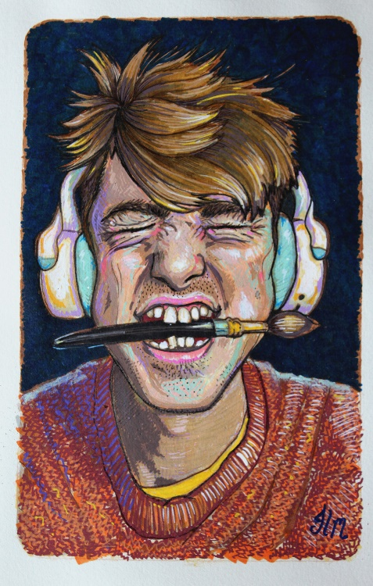
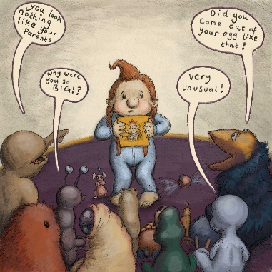
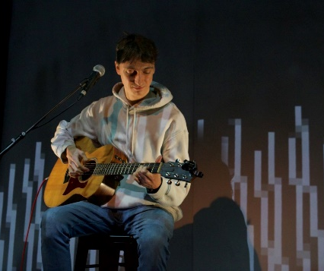
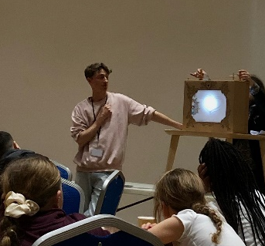
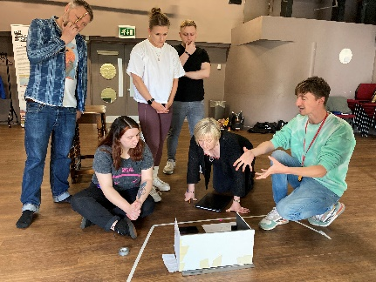
Jonluke McKie
www.jonlukemckie.com
Theatre maker
Theatre director
Illustrator
Facilitator

Slide 6
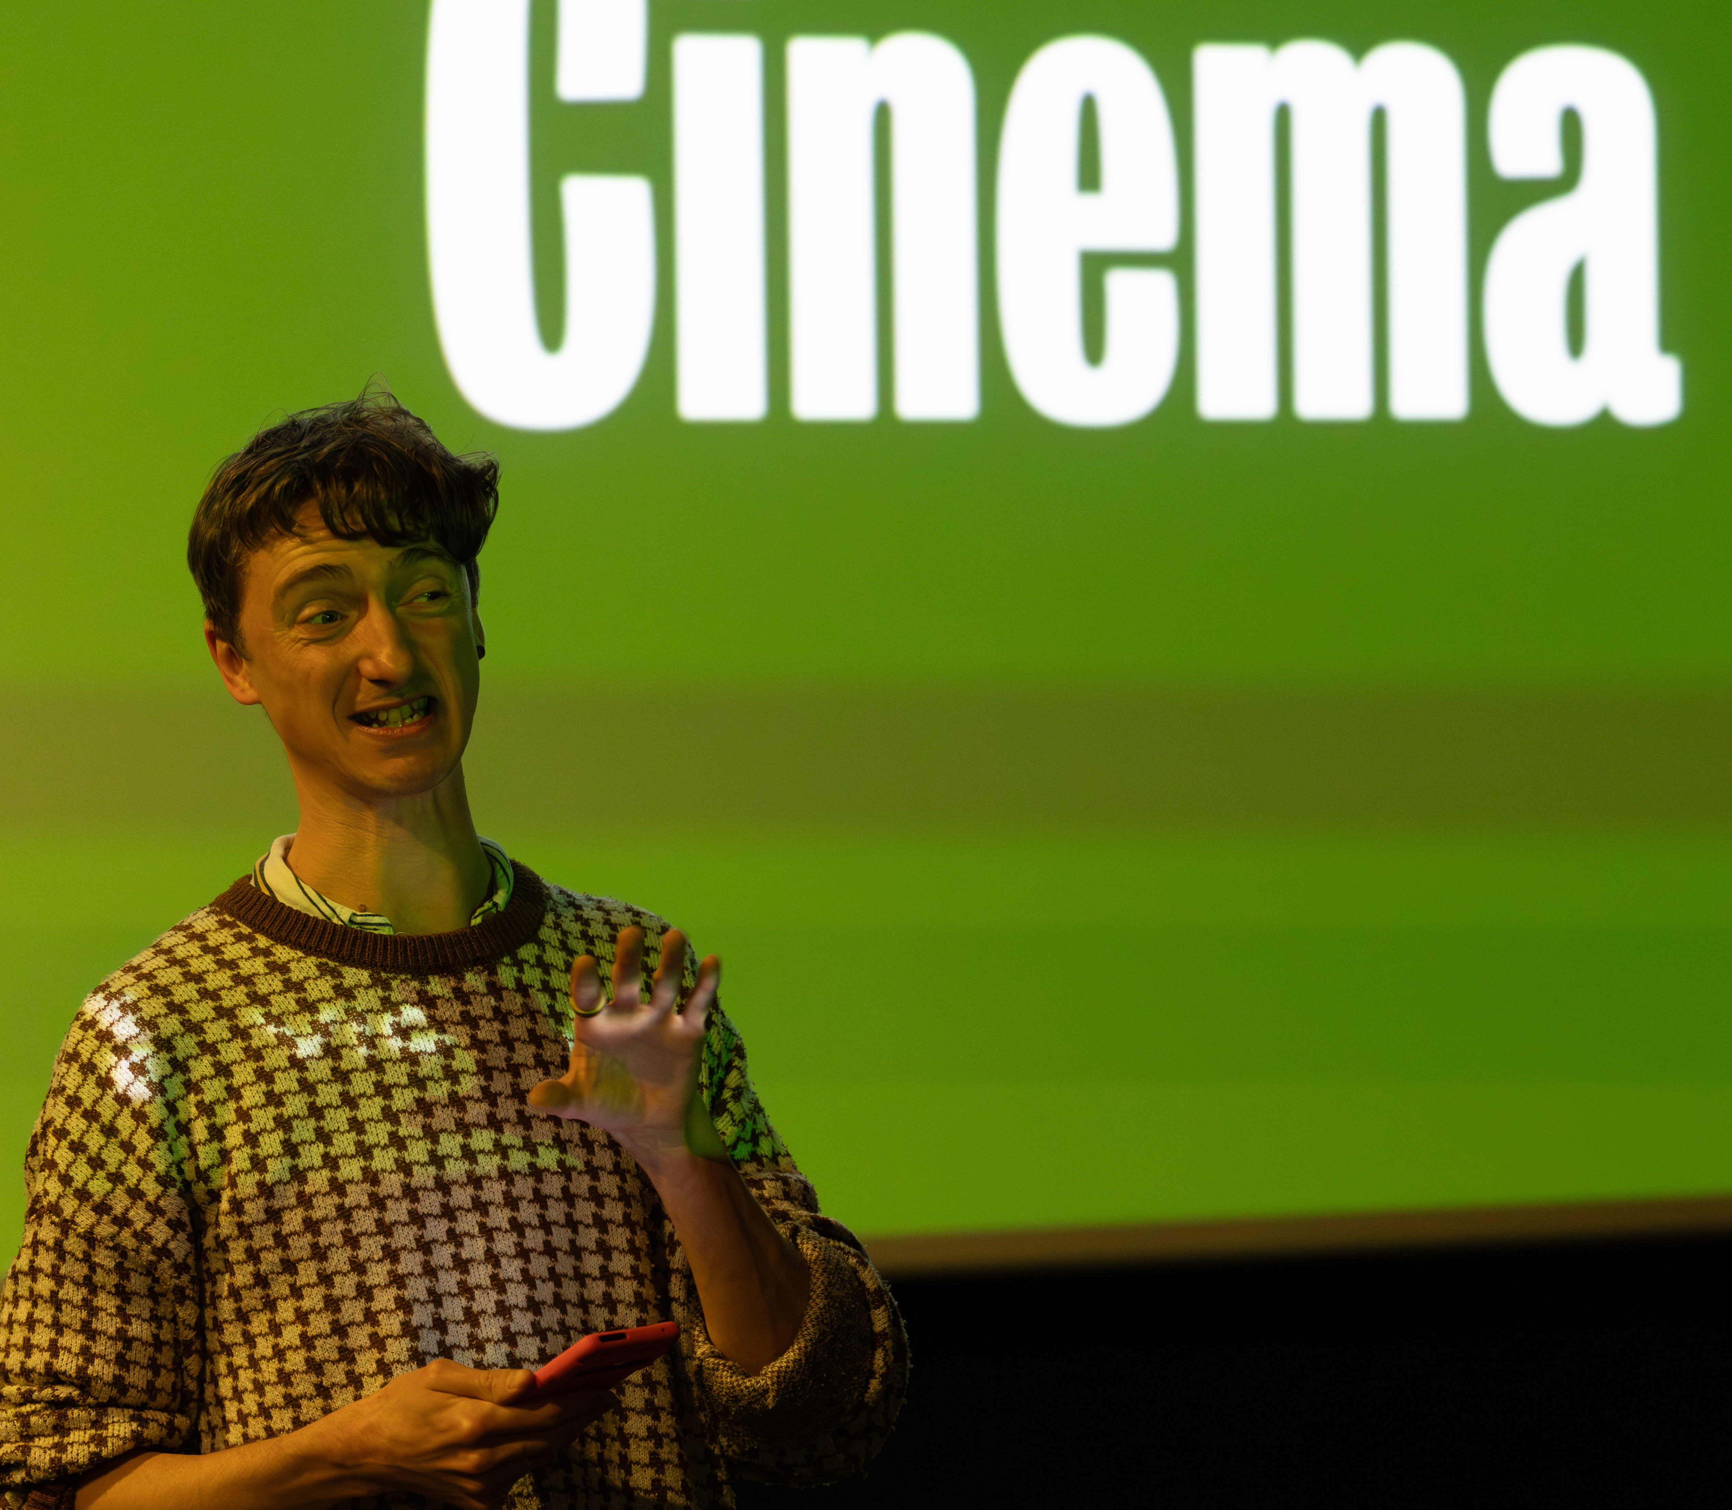
Jonluke McKie
Watch the animated film Jonluke co-created with pupils from Hawthorn Primary School and GLOW Newcastle

Slide 7

Jonluke McKie
About Jonluke
Grew up in a benefit class home
Youth Theatre changed my life!
Went to university for a bet (lost!)
Drama facilitator
Theatre maker/director
Illustrator
MULTIDISCIPLINARY ARTIST

Slide 8
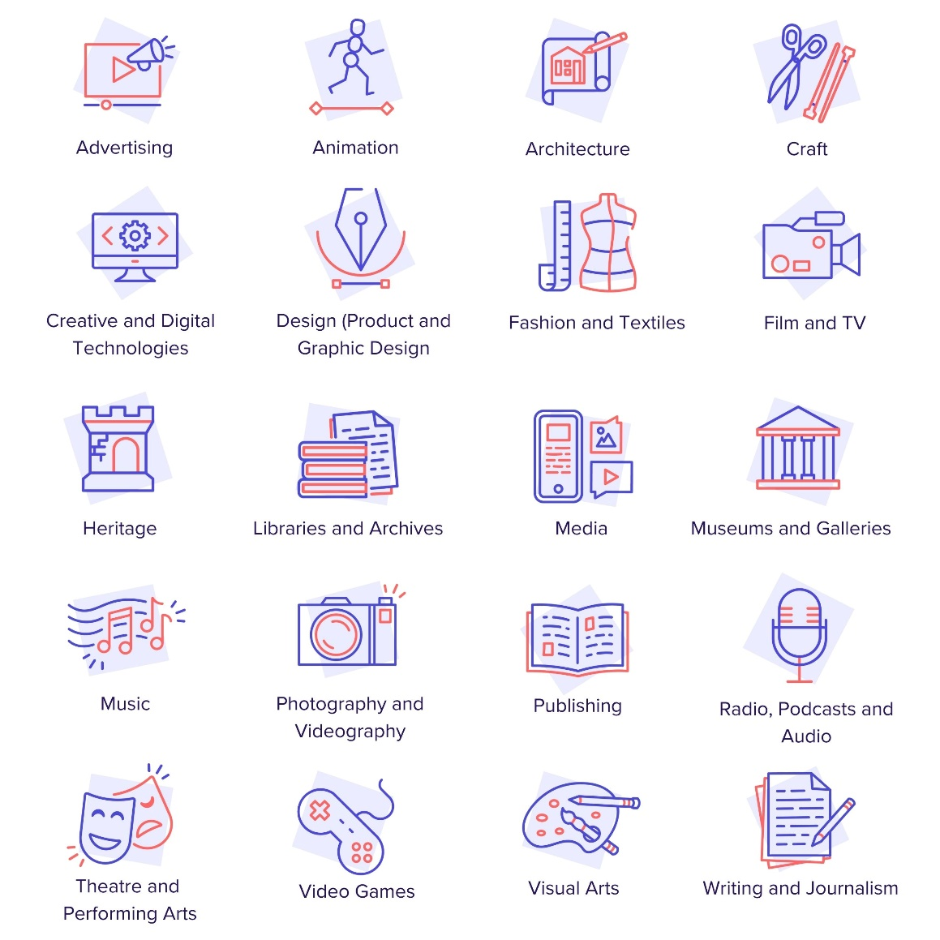

What are the creative industries?
Download our ‘What are the creative industries?’ film here to embed it into
your Presentation (duration 1 min 40).

Slide 9
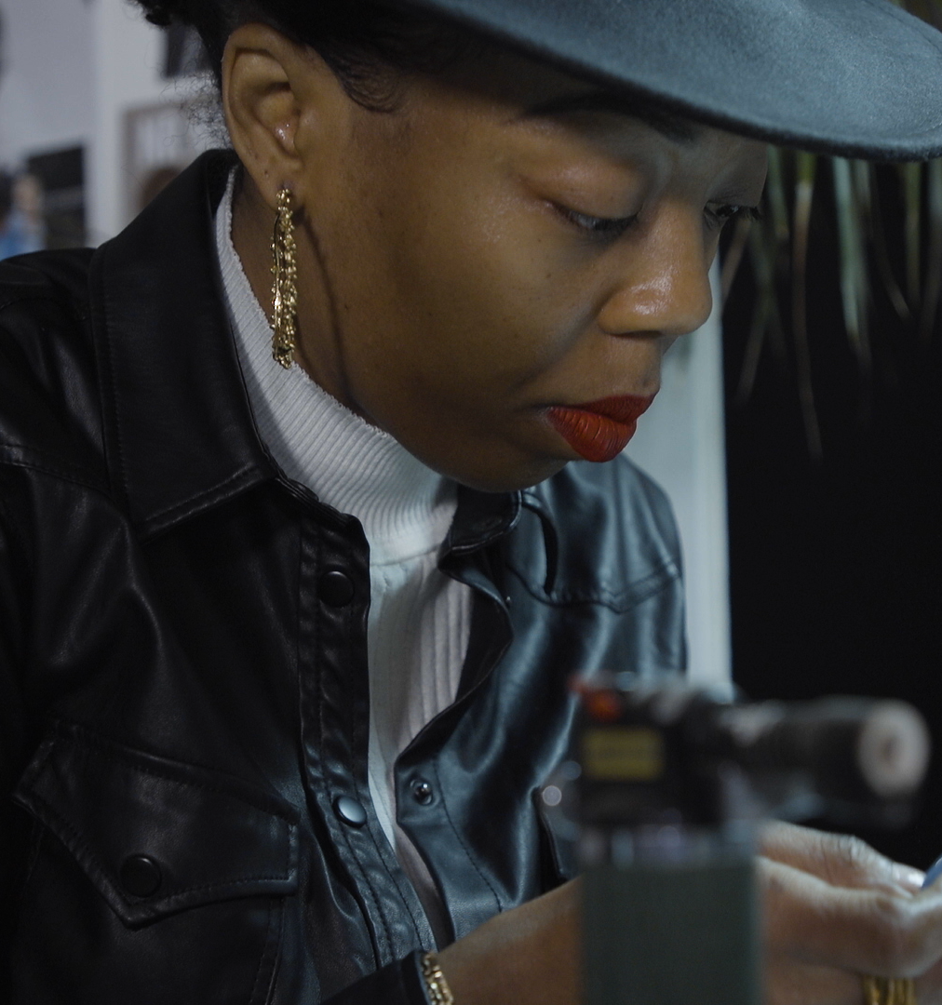
Creativity Matters
1 in 8 businesses in the UK is part of the creative industries.
The creative sector contributes 2.4 million jobs and £124 billion to the UK economy - approximately 5% of the total economy.
The biggest contributor of the 12 subsectors was IT, software and computer services which contributed 2.3% to the UK economy.
Notes:
Sources:
https://www.gov.uk/government/statistics/dcms-sectors-economic-estimates-2019-business-demographics
https://lordslibrary.parliament.uk/arts-and-creative-industries-the-case-for-a-strategy.

Slide 10

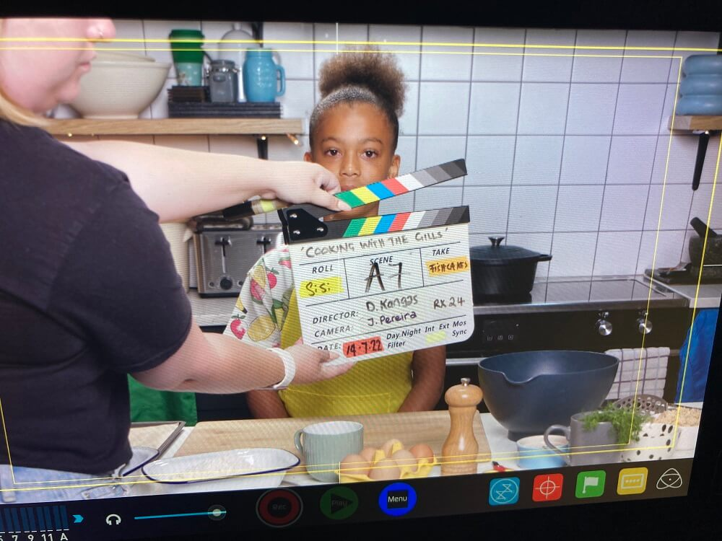
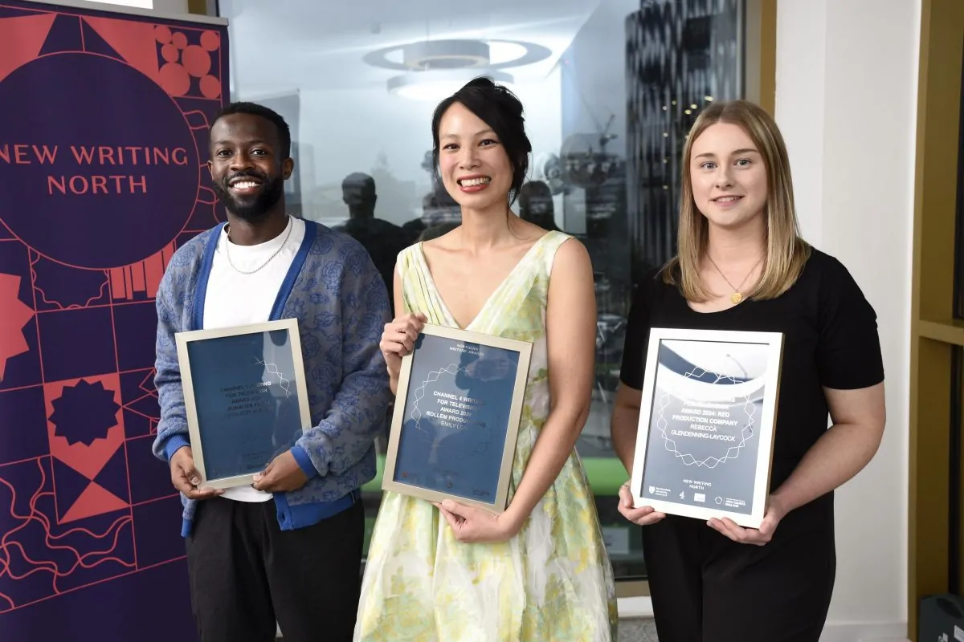

Creativity in the NE
In 2023, the creative industries in the North East totalled 1.35 billion
In the last 10 years, the number of creative jobs has increased by about 10,000
There are now 50,000 creative jobs in the region (still growing)
Big opportunities in screen industries, music, creative tech and other creative content
29% of individuals working in the creative sector are self-employed
Music tourism is up to over 200,000 visitors per year, including 2025 Mercury Awards
Film and TV production in the North East is up 131% over the last three years, with plans for the new Crown Works studio in Sunderland
International demand for UK publishing is set to grow by a further 20% in the next decade - Newcastle will soon have a new national Centre for Writing

Slide 11





Key skills
Creativity
Communication & teamwork
Problem solving
Staying positive
Digital skills

Slide 12
Summary
The creative sector in the NE is full of exciting careers - from coding and design to music and media - in front of the camera, on a stage or being part of the technical or production crew.
With new investment and growing demand, there’s never been a better time to explore creative pathways it is one of the UK’s major success stories and the NE is part of that!
Whether you’re into tech, storytelling, performance, or design - your future could be creative

Slide 13









Jonluke McKie
How might all these different subsectors cross over in one career?
How it works for Jonluke...

Slide 14

Starter Questions:
What is a creative career? Can you think of an example?
What do you like to do? Which creative jobs might use that skill?
Where can you do jobs like that?
4. How can young people get into creative jobs?
5. What is a "freelancer"?

Slide 15
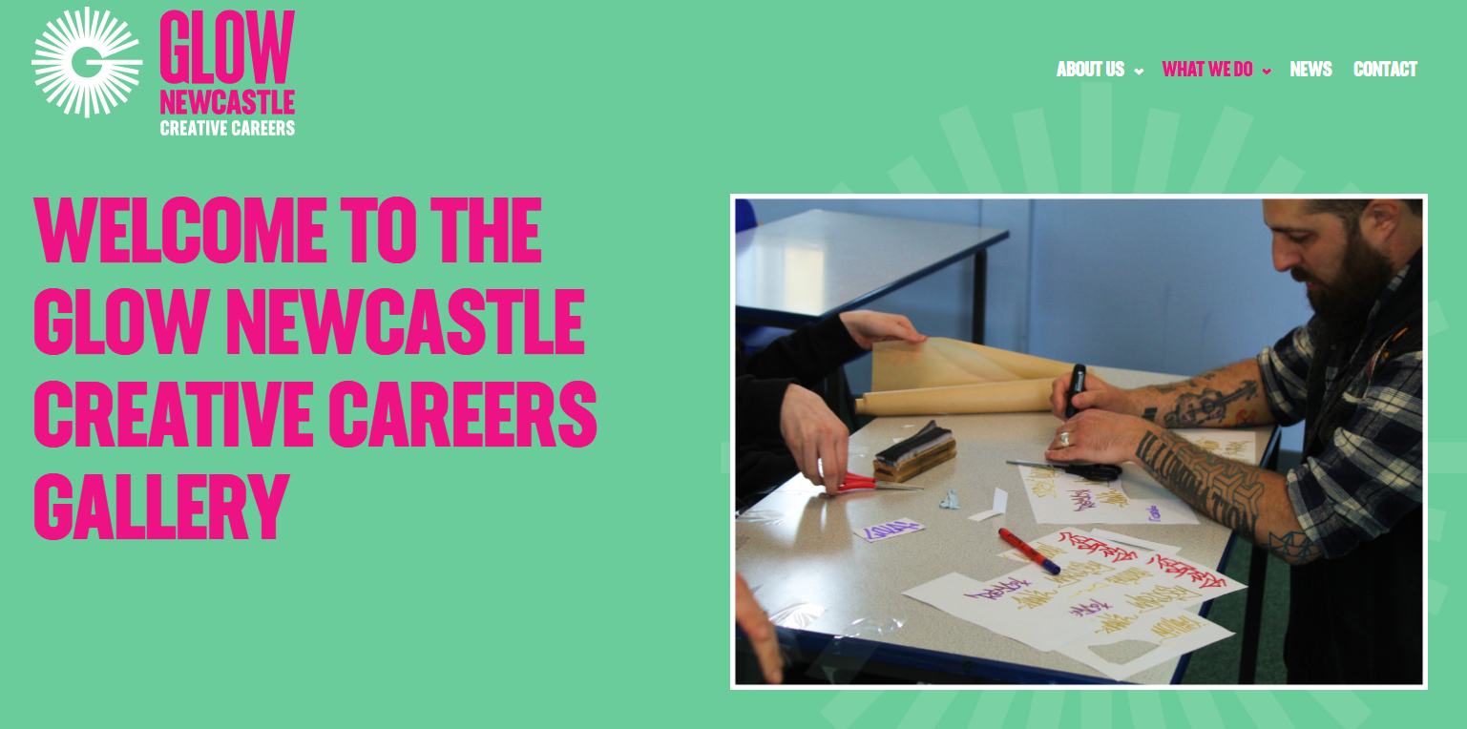
Discover the answers some of our North East Creative Sector workers gave to the same questions.
Choose a video interview from our Creative Careers Gallery for insider links and tips [links in text]

Slide 16


Try it out: North Tyneside
ACT2CAM Whitley Bay: https://youthdrama.tv/
Ramsay's Theatre Stars: https://www.ramseystheatrestars.com/
True Colours Theatre (SEND oriented): https://truecolourstheatre.co.uk/
Whitley Bay Young People's Centre: https://whitleybayyoungpeoplescentre.com/
Discover many more opportunities with your Local Cultural Education Partnership

Slide 17
Try it out: Northumberland
Youth Theatre Alnwick Playhouse: https://alnwickplayhouse.co.uk/classes-workshops/youth-theatre/
Headway Arts (SEND inclusive): https://headwayarts.co.uk/
Mortal Fools Ensemble Young Theatre Company: https://www.mortalfools.org.uk/ensemble-young-company.html https://www.queenshall.co.uk/
Young Writers (Hexham Book Festival and Queen's Hall Arts): https://www.queenshall.co.uk/whats-on/young-writers-school-years-9-10-11
Discover many more opportunities with your Local Cultural Education Partnership

Slide 18

Try it out: Gateshead
New Writing North Young Writers: https://newwritingnorth.com/young-writers/groups/
Gateway Studios Dance: https://www.gatewaystudio.org/
The Sound Rooms Community Music Charity: https://www.thesoundroom.org.uk/
The Baltic Young Artists: https://baltic.art/learning-and-teaching/for-young-people/
The Glasshouse International Centre for Music – Making Music Young People: https://theglasshouseicm.org/make-music/young-people/
Discover many more opportunities with your Local Cultural Education Partnership

Slide 19
Try it out: Newcastle
New Writing North Young Writers: https://newwritingnorth.com/young-writers/groups/
Live Theatre Youth Theatre: https://www.live.org.uk/youththeatre
Northern Stage Taking Part (various groups including acting, costume design, technical and production, scriptwriting): https://northernstage.co.uk/taking-part/
Theatre Royal, Newcastle Youth Theatre: https://www.theatreroyal.co.uk/take-part/youth-theatre/
Laing Art Gallery L-INK young curators and producers: https://www.northeastmuseums.org.uk/laing/about-link
Discover many more opportunities with your Local Cultural Education Partnership

Slide 20

Try it out: Durham
New Writing North Young Writers: https://newwritingnorth.com/young-writers/groups/
Second Wave Youth Arts community group https://secondwave.org.uk/
The Forge – youth arts community groups: https://culturedurham.org.uk/insights/the-forge/
Gala Youth Theatre – drama group: https://galadurham.co.uk/engage/gala-youth-theatre/
East Durham Creates: https://www.eastdurhamtrust.org.uk/eastdurhamcreates.html
Discover many more opportunities with your Local Cultural Education Partnership

Slide 21
Try it out: South Tyneside
New Writing North Young Writers: https://newwritingnorth.com/young-writers/groups/
Arts and Crafts Club at The Word: https://theworduk.org/whats-on/arts-and-crafts-club/
The Word – Creative Clubs: https://theworduk.org/whats-on/
The Customs House Youth Theatre: https://customshouse.co.uk/takepart/youth-theatre/
STAMP – South Tyneside Academy of Music Performance: https://www.st-amp.co.uk/
Ocean Road Community Association – youth dance: https://oceanroadca.com/youth-work/
Discover many more opportunities with your Local Cultural Education Partnership

Slide 22
Myth busting…
The Creative industries are too ________?
A job in the creative industries is not __ _____ ____?
You need ____ __ _____ __ ____ ____ to get a job in the creative industries
The creative industries are only for _____ people
You have to live in _________ to have a career in the creative industries

Slide 23
Myth busting…
The Creative industries are too competitive
A job in the creative industries is not a ‘proper job’
You need friends or family in high places to get a job in the creative industries
The creative industries are only for ‘arty’ people
You have to live in London to have a career in the creative industries

